Slide 1
Wafermap Analysis Report
Generated on 2026-02-23 10:15

Slide 2
Gage R&R Report - Agenda
# | Group | Parameters | Pages | Slides
1 | 📋 Agenda | - | Page 2 | 1
2 | 📖 Calculation Parameters | - | Page 3 | 1
3 | DC_SHORT | 5 | Page 4-8 | 5
4 | Dc_Debug | 1 | Page 9-13 | 5
5 | Dc_Pwr | 10 | Page 14-18 | 5
Total: 5 Groups | 16 Parameters | 17 Slides

Slide 3
Gage R&R - Calculation Parameters
BASIC STATISTICAL VALUES
Mean (Mittelwert):
Average of all measurements across all files and dies.
Mean = Σ(xi) / n
Std Dev (Standardabweichung):
Measure of dispersion around the mean.
σ = √[Σ(xi - Mean)² / n]
Range (Spannweite):
Difference between maximum and minimum.
Range = Max - Min
LSL / USL (Spec Limits):
Statistical limits (k = sigma factor).
LSL = Mean - kσ | USL = Mean + kσ
GAGE R&R COMPONENTS
Repeatability (EV):
Variation within measurements of one file (equipment).
EV = Mean(σ within each file)
Reproducibility (AV):
Variation between files/operators/trials.
AV = σ(file means)
GRR Total:
Combined measurement system variation.
GRR = R̄ / d₂ (Range Method)
ASSESSMENT METRICS
%GRR (Prozent GRR):
GRR as percentage of total variation or tolerance.
%GRR = (GRR / TV) × 100 or (GRR / Tolerance) × 100
ndc (Using Total Variation):
Number of distinct categories the system can distinguish.
ndc = 1.41 × (TV / GRR)
ASSESSMENT CRITERIA (AIAG MSA)
🟢 EXCELLENT: %GRR < 10%
Measurement system is acceptable.
🟡 ACCEPTABLE: 10% ≤ %GRR < 30%
May be acceptable depending on application.
🔴 UNACCEPTABLE: %GRR ≥ 30%
Measurement system must be improved.
ndc ≥ 5: Good measurement system
Can distinguish ≥ 5 distinct categories.
INTERPRETATION
• High Repeatability → Equipment/method problem
• High Reproducibility → Operator/process/time problem
• ndc should be ≥ 5 for a good measurement system
• Values outside LSL/USL indicate outliers

Slide 4
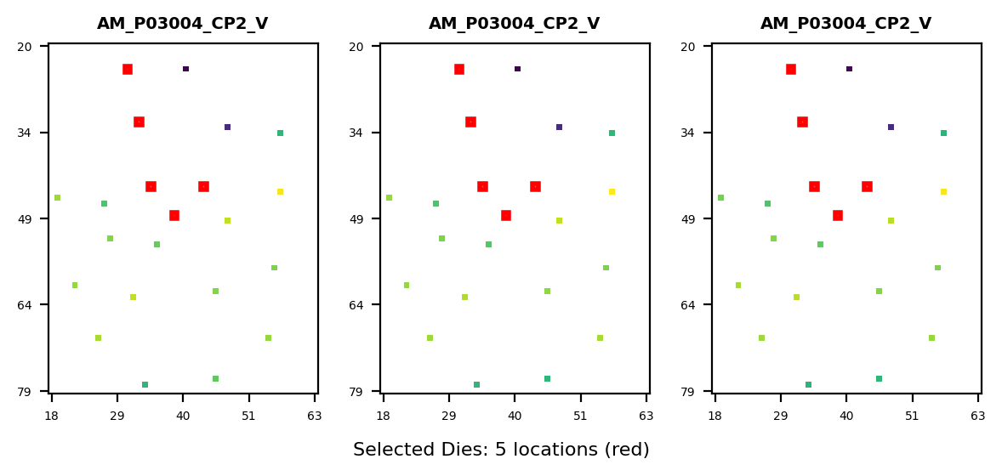
Gage R&R Study Overview - DC_SHORT
Study Configuration
• Files/Trials: 3 • Dies/Parts: 5 • Parameters: 16
Parameters Analyzed:
1. 10020001: LOW_VDD10_FV0P1_X VDD10 22.g404hc <
2. 10020002: LOW_VDD18IO_FV0P1_X VDD18IO 22.a402
3. 10020003: LOW_AVDD18_FV0P1_X AVDD18 22.c403 <
4. 10020004: LOW_VQPSEFUSE_FV0P1_X VQPS_EFUSE 22
5. 10020005: LOW_AVEE_FV0P1_X AVEE 20.w402 <> DC
Overall Result: FAIL
✗ Gage R&R FAILED for 5 parameter(s) due to excessive measurement variation (>30%). Failing parameters: DC_SHORT_LOW_VQPSEFUSE_FV, DC_SHORT_LOW_VDD10_FV0P1_, DC_SHORT_LOW_AVDD18_FV0P1 (+2 more) Recommendation: Review measurement equipment, operator training, or test methodology.
Assessment: 0 Excellent | 0 Acceptable | 5 Unacceptable

Slide 5
Gage R&R - Calculation Parameters (Formulas)
BASIC STATISTICAL VALUES
Mean (Mittelwert):
Average of all measurements across all files and dies.
Mean = Σ(xi) / n
Std Dev (Standardabweichung):
Measure of dispersion around the mean.
σ = √[Σ(xi - Mean)² / n]
Range (Spannweite):
Difference between maximum and minimum.
Range = Max - Min
LSL / USL (Spec Limits):
Statistical limits (k = sigma factor).
LSL = Mean - kσ | USL = Mean + kσ
GAGE R&R COMPONENTS
Repeatability (EV):
Variation within measurements of one file (equipment).
EV = Mean(σ within each file)
Reproducibility (AV):
Variation between files/operators/trials.
AV = σ(file means)
GRR Total:
Combined measurement system variation.
GRR = R̄ / d₂ (Range Method)
Part Variation (PV):
True variation between parts/dies.
PV = σ(part means)
Total Variation (TV):
Total observed variation.
TV = √(PV² + GRR²)
ASSESSMENT METRICS
%GRR (Prozent GRR):
GRR as percentage of total variation or tolerance.
%GRR = (GRR / TV) × 100 or (GRR / Tolerance) × 100
ndc (Using Part Variation):
Number of distinct categories the system can distinguish.
ndc = 1.41 × (PV / GRR)
ASSESSMENT CRITERIA (AIAG MSA)
🟢 EXCELLENT: %GRR < 10%
Measurement system is acceptable.
🟡 ACCEPTABLE: 10% ≤ %GRR < 30%
May be acceptable depending on application.
🔴 UNACCEPTABLE: %GRR ≥ 30%
Measurement system must be improved.
ndc ≥ 5: Good measurement system
Can distinguish ≥ 5 distinct categories.
INTERPRETATION
• High Repeatability → Equipment/method problem
• High Reproducibility → Operator/process/time problem
• ndc should be ≥ 5 for a good measurement system
• Values outside LSL/USL indicate outliers

Slide 6
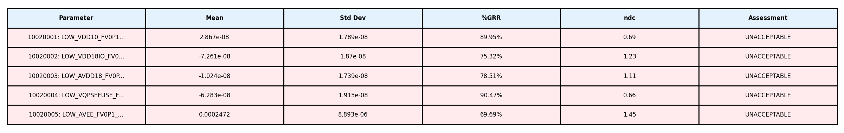
Gage R&R Analysis Summary - DC_SHORT
Study Information: • Files (Operators/Trials): 3 • Dies (Parts): 5 • Parameters Analyzed: 16

Slide 7
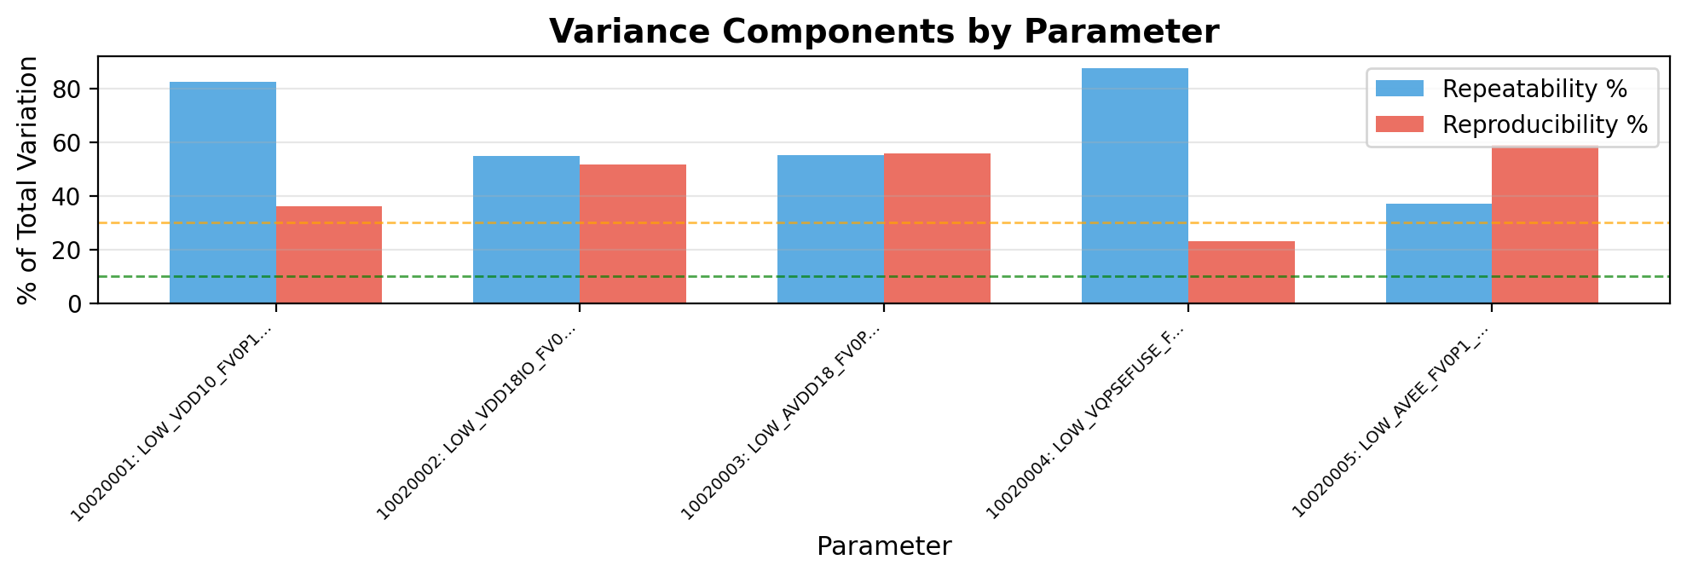
Gage R&R - Variance Components - DC_SHORT
Interpretation:
• Repeatability (blue): Variation when same operator measures same part multiple times (equipment variation)
• Reproducibility (red): Variation between different operators/trials measuring same part (operator variation)
→ Analysis: Repeatability (63.4%) > Reproducibility (45.1%). Equipment/method variation is dominant. Consider equipment calibration or method refinement.

Slide 8
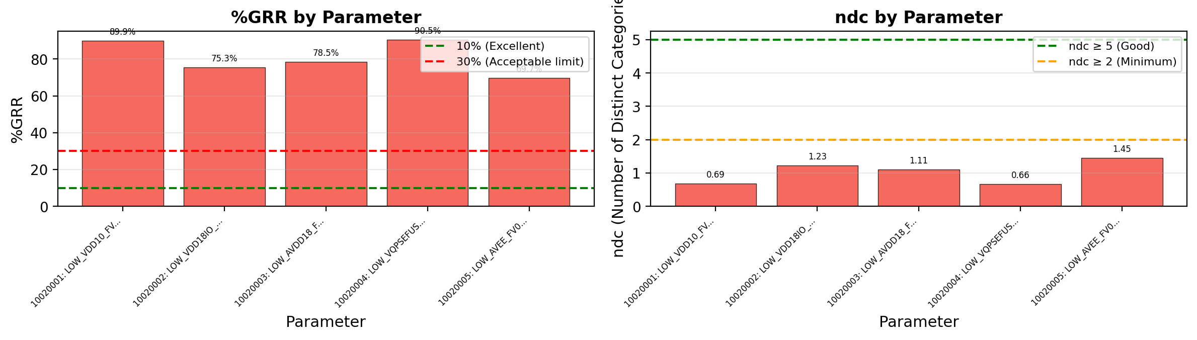
Gage R&R - %GRR and ndc - DC_SHORT
Acceptance Criteria & Interpretation:
• %GRR < 10%: EXCELLENT - Measurement system is excellent for this application
• %GRR 10-30%: ACCEPTABLE - May be acceptable depending on application criticality
• %GRR > 30%: UNACCEPTABLE - Measurement system needs improvement
• ndc (Number of Distinct Categories): Indicates how many distinct categories the measurement can reliably distinguish. ndc ≥ 5 is recommended.
⚠ Warning: 5 parameter(s) have ndc < 5: DC_SHORT_LOW_VDD10_F, DC_SHORT_LOW_VDD18IO, DC_SHORT_LOW_AVDD18_

Slide 9
Gage R&R Study Overview - Dc_Debug
Study Configuration
• Files/Trials: 3 • Dies/Parts: 5 • Parameters: 16
Parameters Analyzed:
1. 30025001: TESTTIME_TIMESTAMP_X -1 <> DC_DEBU
Overall Result: FAIL
✗ Gage R&R FAILED for 1 parameter(s) due to excessive measurement variation (>30%). Failing parameters: DC_DEBUG_TESTTIME_TIMESTA Recommendation: Review measurement equipment, operator training, or test methodology.
Assessment: 0 Excellent | 0 Acceptable | 1 Unacceptable

Slide 10
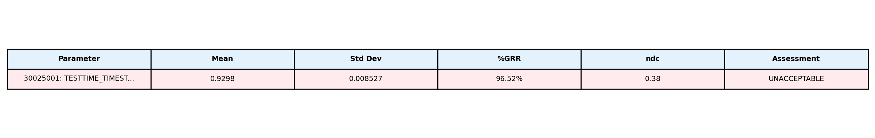
Gage R&R Analysis Summary - Dc_Debug
Study Information: • Files (Operators/Trials): 3 • Dies (Parts): 5 • Parameters Analyzed: 16

Slide 11
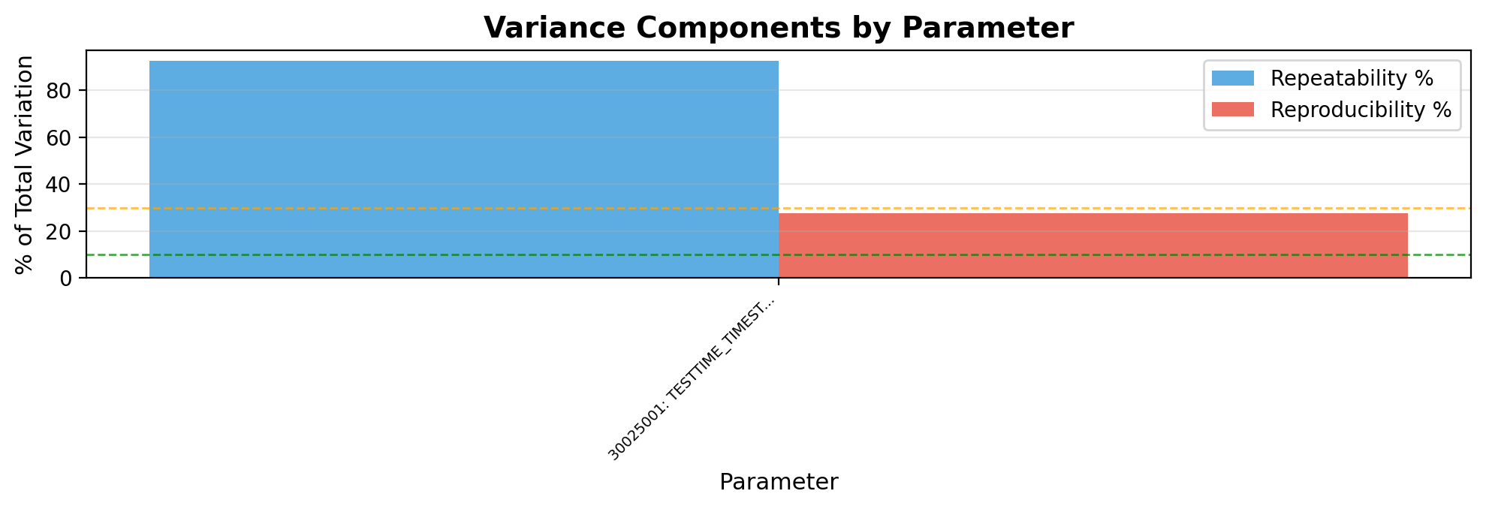
Gage R&R - Variance Components - Dc_Debug
Interpretation:
• Repeatability (blue): Variation when same operator measures same part multiple times (equipment variation)
• Reproducibility (red): Variation between different operators/trials measuring same part (operator variation)
→ Analysis: Repeatability (92.5%) > Reproducibility (27.5%). Equipment/method variation is dominant. Consider equipment calibration or method refinement.

Slide 12
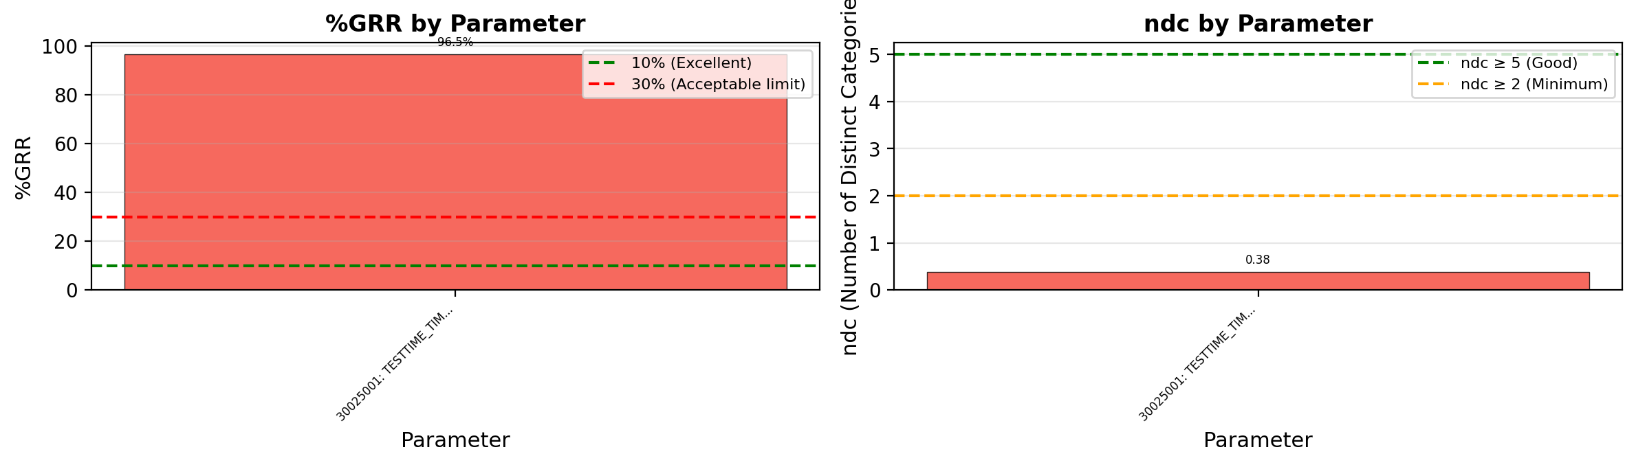
Gage R&R - %GRR and ndc - Dc_Debug
Acceptance Criteria & Interpretation:
• %GRR < 10%: EXCELLENT - Measurement system is excellent for this application
• %GRR 10-30%: ACCEPTABLE - May be acceptable depending on application criticality
• %GRR > 30%: UNACCEPTABLE - Measurement system needs improvement
• ndc (Number of Distinct Categories): Indicates how many distinct categories the measurement can reliably distinguish. ndc ≥ 5 is recommended.
⚠ Warning: 1 parameter(s) have ndc < 5: DC_DEBUG_TESTTIME_TI

Slide 13
Gage R&R Study Overview - Dc_Pwr
Study Configuration
• Files/Trials: 3 • Dies/Parts: 5 • Parameters: 16
Parameters Analyzed:
1. 11405006: STATIC_VDD10_VNOM_X VDD10 22.g404hc
2. 11405007: STATIC_VDD18IO_VNOM_X VDD18IO 22.a4
3. 11405008: STATIC_AVDD18_VNOM_X AVDD18 22.c403
4. 11405009: STATIC_AVEE_VNOM_X AVEE 20.w402 <>
5. 11405010: STATIC_TotalPower_VNOM_X TotalPower
6. 11405011: STATIC_VDD10_VMIN_X VDD10 22.g404hc
7. 11405012: STATIC_VDD18IO_VMIN_X VDD18IO 22.a4
8. 11405013: STATIC_AVDD18_VMIN_X AVDD18 22.c403
... +2 more
Overall Result: FAIL
✗ Gage R&R FAILED for 6 parameter(s) due to excessive measurement variation (>30%). Failing parameters: DC_PWR_STATIC_AVEE_VMIN_X, DC_PWR_STATIC_AVDD18_VMIN, DC_PWR_STATIC_AVDD18_VNOM (+3 more) Recommendation: Review measurement equipment, operator training, or test methodology.
Assessment: 0 Excellent | 4 Acceptable | 6 Unacceptable

Slide 14
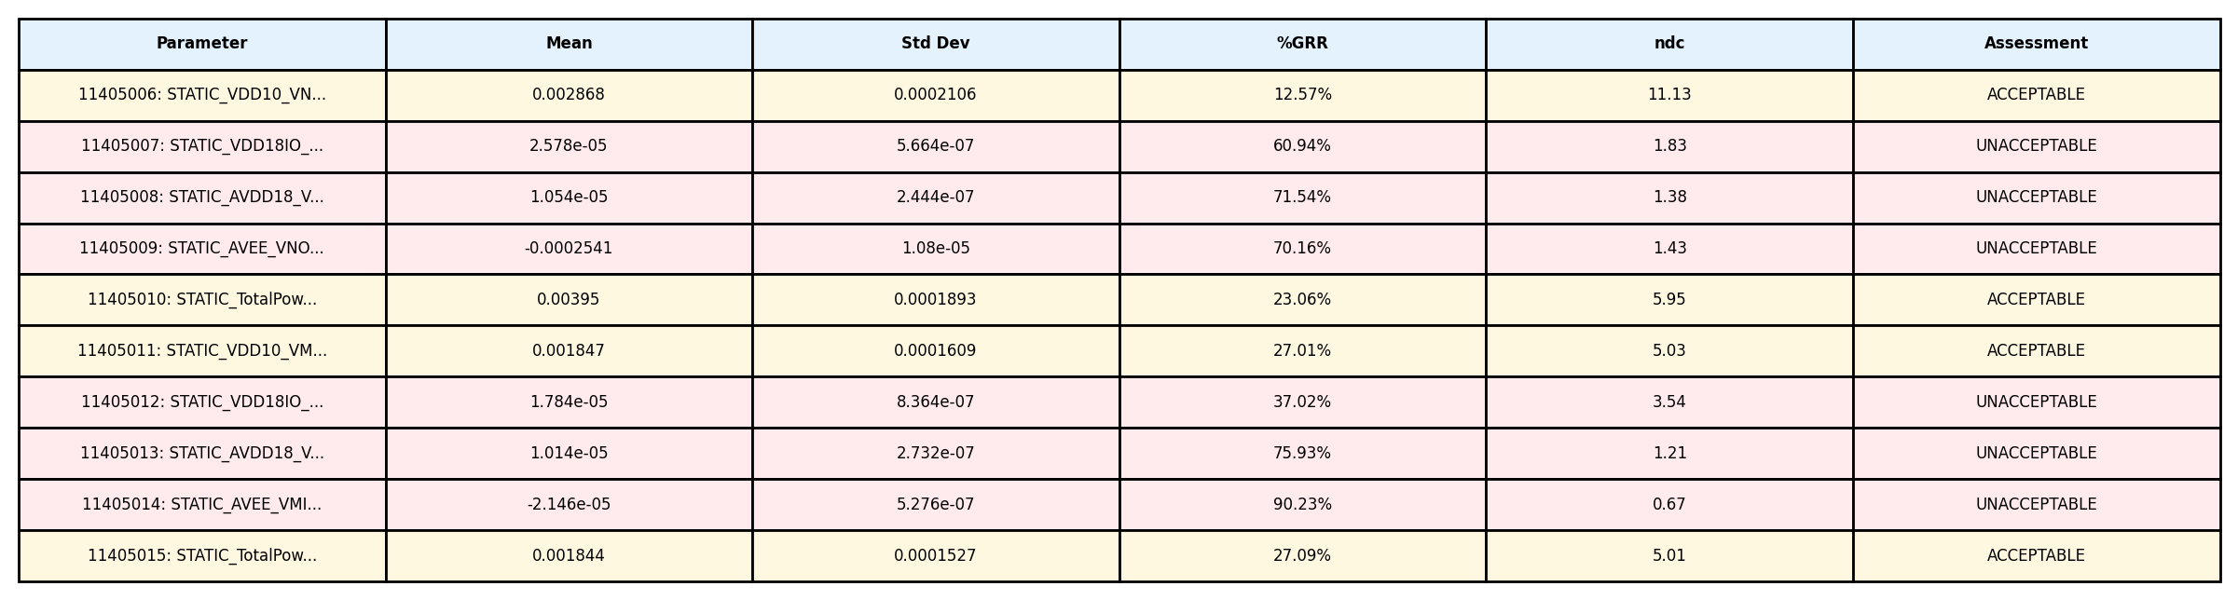
Gage R&R Analysis Summary - Dc_Pwr
Study Information: • Files (Operators/Trials): 3 • Dies (Parts): 5 • Parameters Analyzed: 16

Slide 15
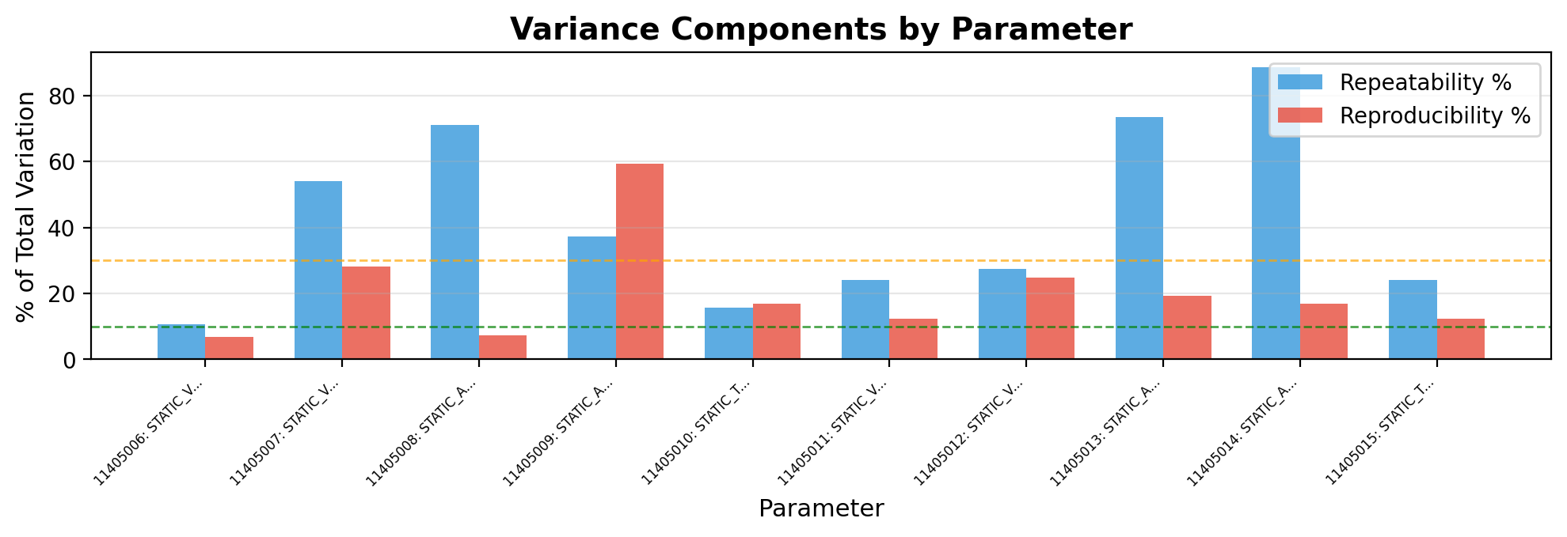
Gage R&R - Variance Components - Dc_Pwr
Interpretation:
• Repeatability (blue): Variation when same operator measures same part multiple times (equipment variation)
• Reproducibility (red): Variation between different operators/trials measuring same part (operator variation)
→ Analysis: Repeatability (42.7%) > Reproducibility (20.4%). Equipment/method variation is dominant. Consider equipment calibration or method refinement.

Slide 16
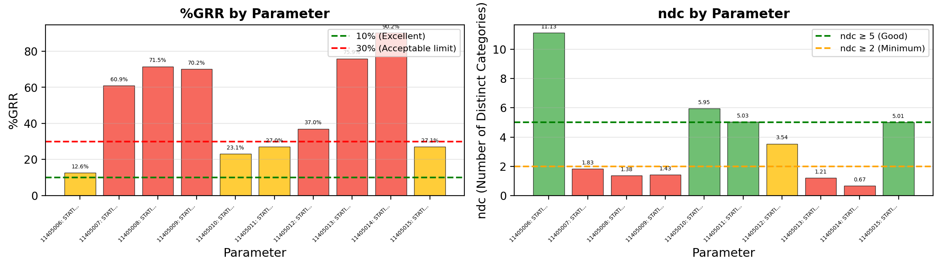
Gage R&R - %GRR and ndc - Dc_Pwr
Acceptance Criteria & Interpretation:
• %GRR < 10%: EXCELLENT - Measurement system is excellent for this application
• %GRR 10-30%: ACCEPTABLE - May be acceptable depending on application criticality
• %GRR > 30%: UNACCEPTABLE - Measurement system needs improvement
• ndc (Number of Distinct Categories): Indicates how many distinct categories the measurement can reliably distinguish. ndc ≥ 5 is recommended.
⚠ Warning: 6 parameter(s) have ndc < 5: DC_PWR_STATIC_VDD18I, DC_PWR_STATIC_AVDD18, DC_PWR_STATIC_AVEE_V

